Slide 1
Outlook Email/Calendaring Migration

Slide 2
What May Not Migrate
Outlook:
Filters/Rules
Color Coding
Flags
Categories
Meeting Ownership
NOTE: Capture Email & Calendar Settings – The following slides guide you through the process

Slide 3
Prepare for Migration:
MyMail (current) Email

Slide 4
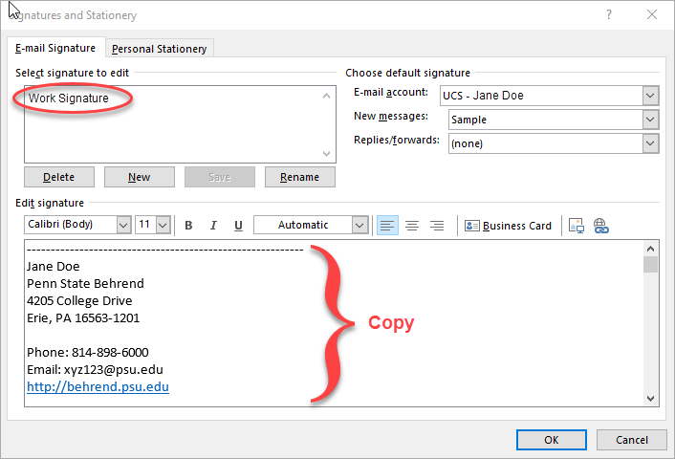
Email Signatures
Create new email message, click Signature button > Signatures… Select signature. Take screenshot or copy details to Word doc.

Slide 5
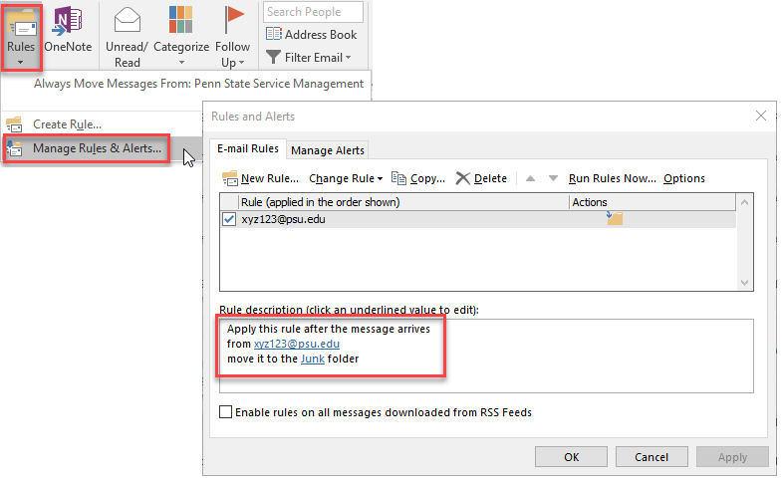
Email Filters/Rules
Click Rules button > Manage Rules & Alerts. Take screenshot or copy details to Word or Excel doc.

Slide 6
Prepare for Migration:
MyMail (current) Calendars

Slide 7
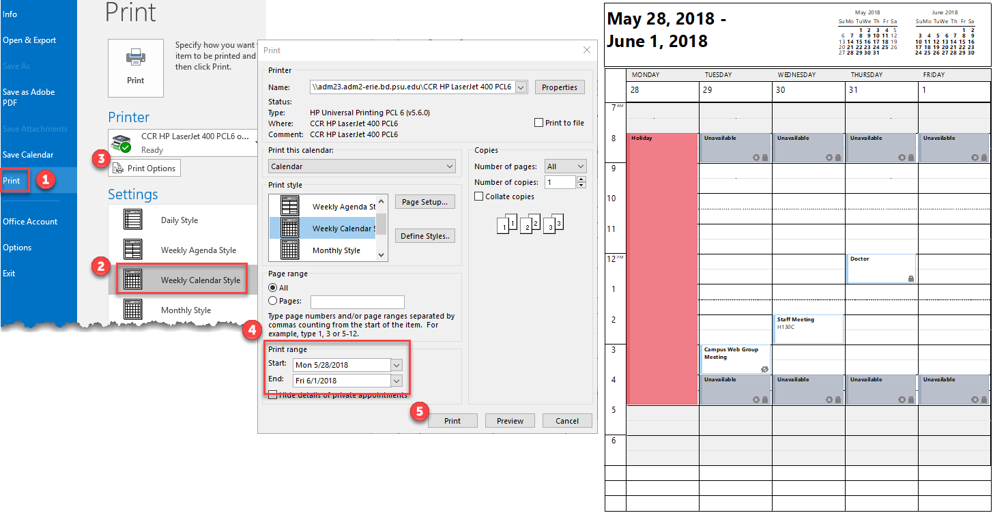
Print Calendar
Print your calendar for the week of migration.
Go to Calendar view. Select File > Print, choose desired setting (ex: Daily, Weekly Agenda, or Weekly Calendar). Click Print Options, select start & end dates; click Print.

Slide 8

Your Calendars
These are calendars that you have created; it also includes the default Calendar.
Go to Calendar view. Take screenshot.

Slide 9
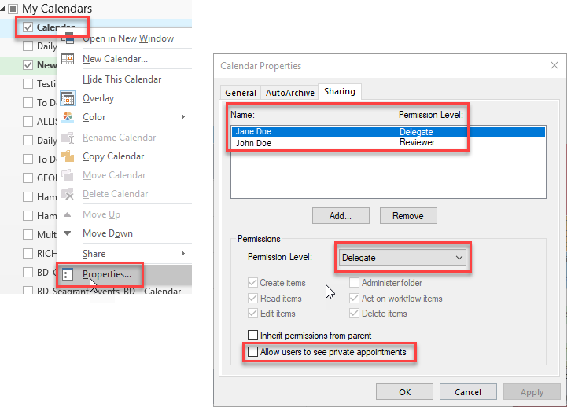
Your Shared Calendars
These are your calendars that you share with others.
Right-mouse click on calendar > Properties & click Sharing tab. Take screenshot. Repeat for each person.

Slide 10
Delegator/Delagate
Delegator (manager): Allows another person to manage their email and/or calendars.
Delegate (staff asst): The person who manages email and/or calendars on behalf of their manager.
Delegator: Make note of who is the delegate
Delegate: Make note of who is the delegator

Slide 11
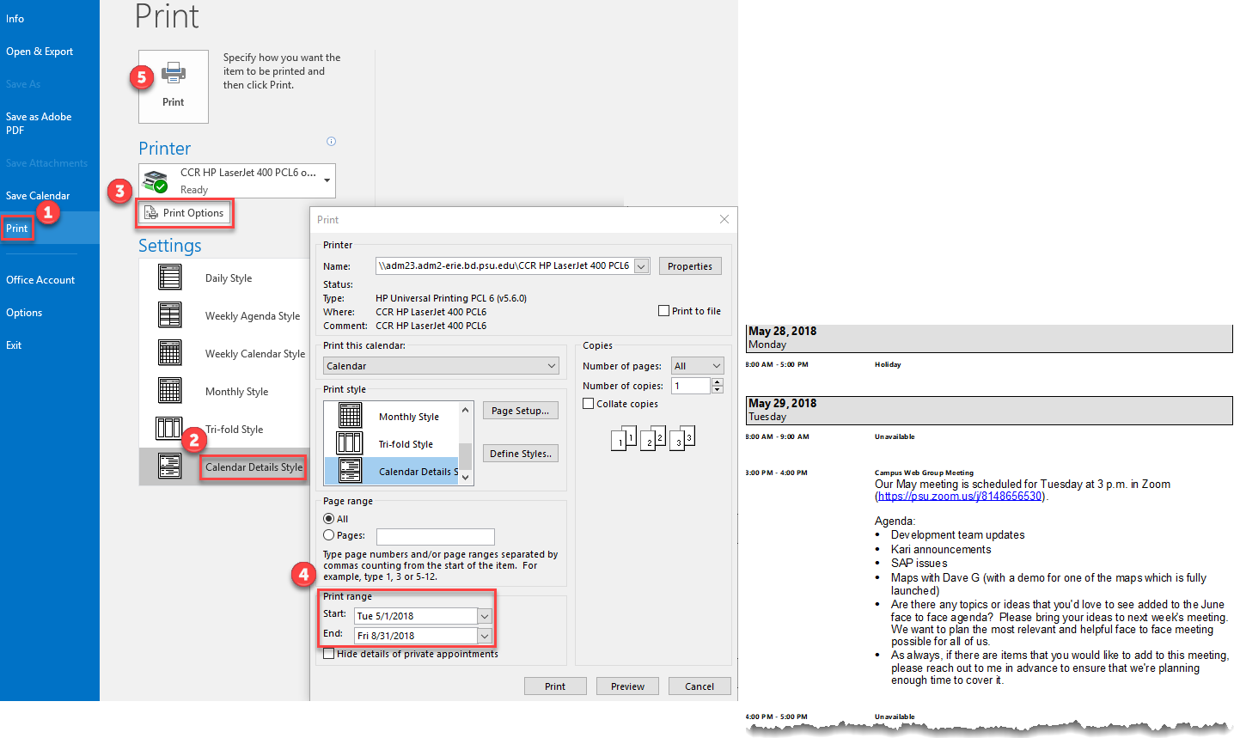
Meetings (Outlook)
Make note of your meetings and recurring meetings.
Go to Calendar view. Select File > Print, choose desired setting (ex: Calendar Details). Click Print Options, select start & end dates; click Print.

Slide 12
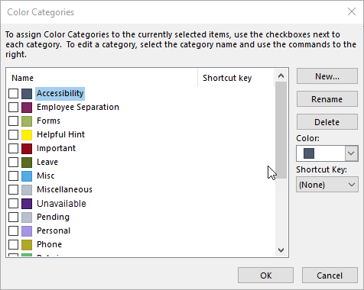
Categories/Tags (1 of 2)
Open meeting, select: Categorize button > All Categories. Take screenshot.

Slide 13
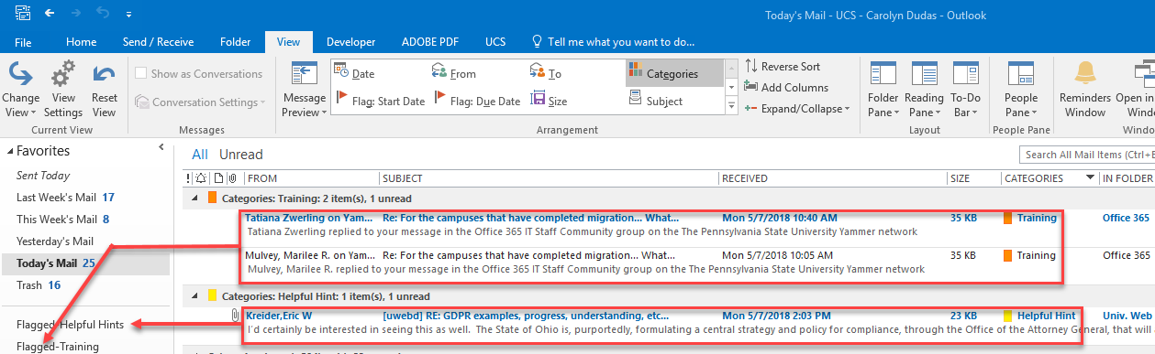
Categories/Tags (2 of 2)
Create folders for tagged items. Move items marked with a category/tag into these folders. (That way you can easily locate tagged items.)

Slide 14
Outlook on the Desktop
After Migration

Slide 15
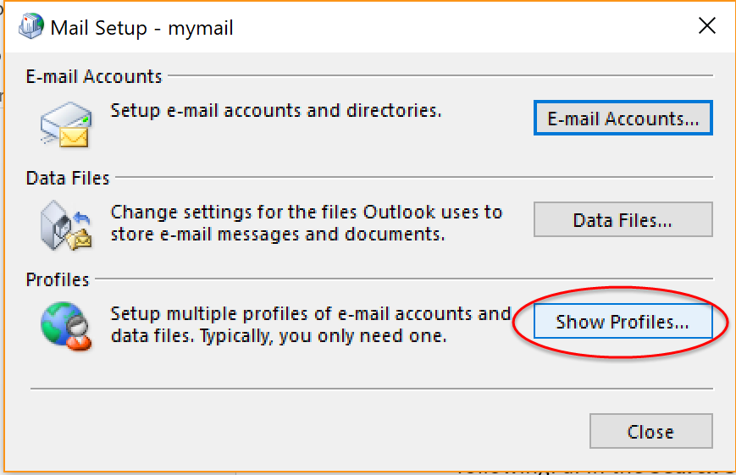
Desktop – Remove Profile (1 of 2)
Remove Old Profile:
a. In the Search Screen (bottom left of your desktop) type “Control Panel” and click on the option that comes up.
b. When the Control Panel window appears,
find the Mail icon and double click it.
c. When the Mail Setup window appears,
click on the “Show Profiles” button.

Slide 16
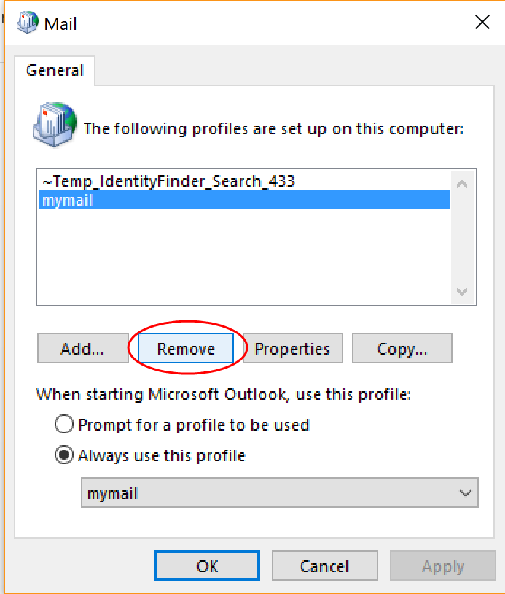
Desktop –Remove Profile (2 of 2)
When the Mail General window appears, highlight your Profile and click on the “Remove” button. Repeat this step for all profiles you have configured.

Slide 17
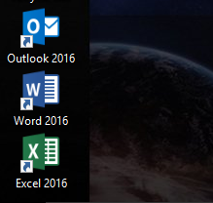
Desktop – Launching Outlook (1 of 7)
After you have removed any existing profiles for Outlook locate the shortcut for Outlook 2016 and launch the program

Slide 18
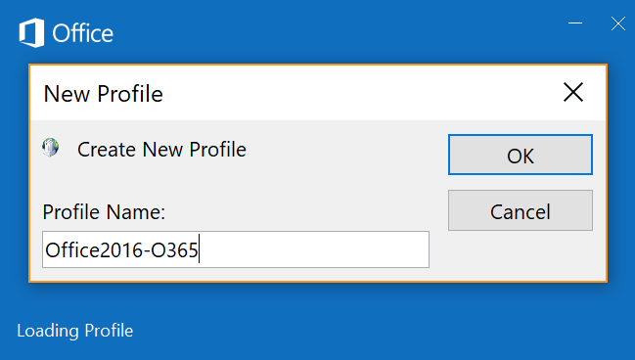
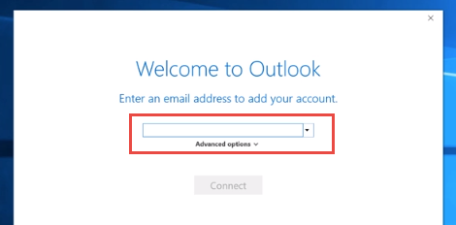
Desktop – Launching Outlook (2 of 7)
“New Profile” will appear – name this however you wish
The “Sign in” will appear. Place your email abc123@psu.edu into the text field. Choose the “Connect” button.

Slide 19
Desktop – Launching Outlook (3 of 7)
You will see the following on your desktop

Slide 20
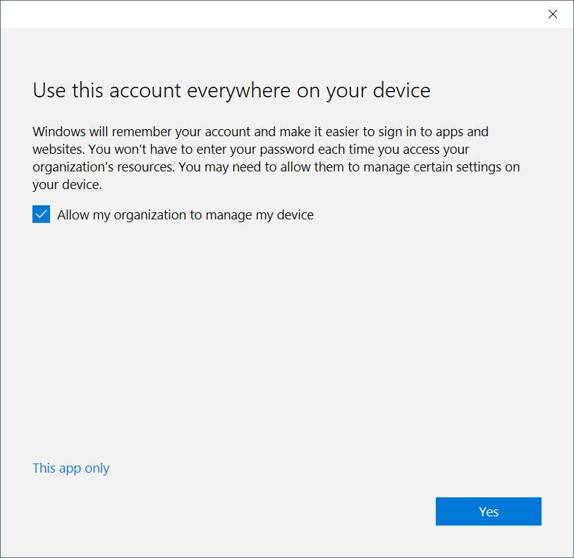
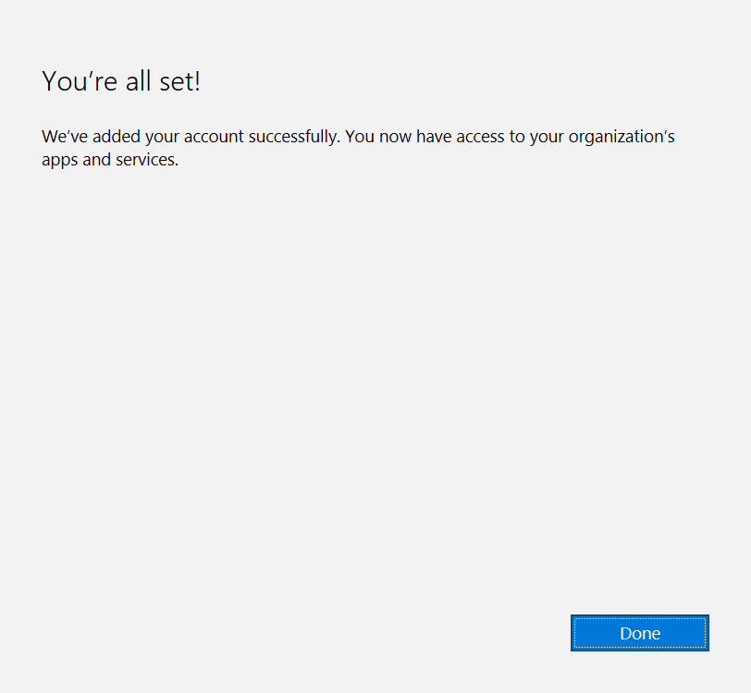
Desktop – Launching Outlook (4 of 7)
You will see the following on your desktop

Slide 21
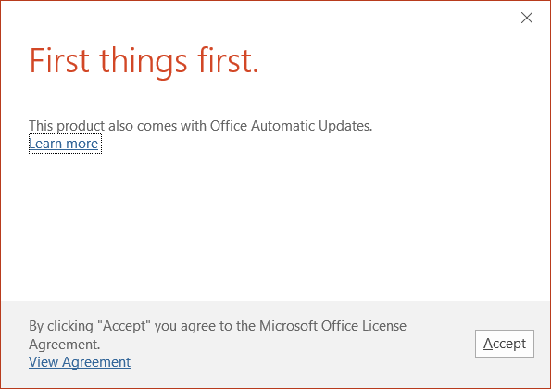
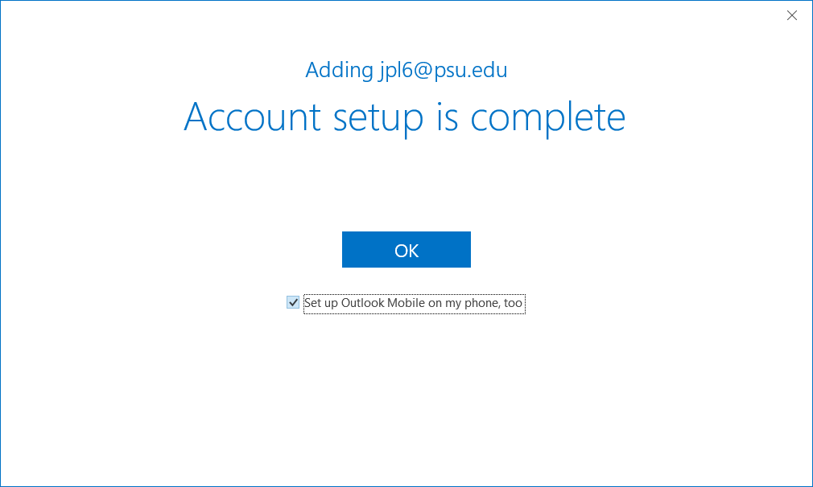
Desktop – Launching Outlook (5 of 7)
You will see the following on your desktop
NOTE: If you check the box on the slide below you will see the screen shot on the next page

Slide 22
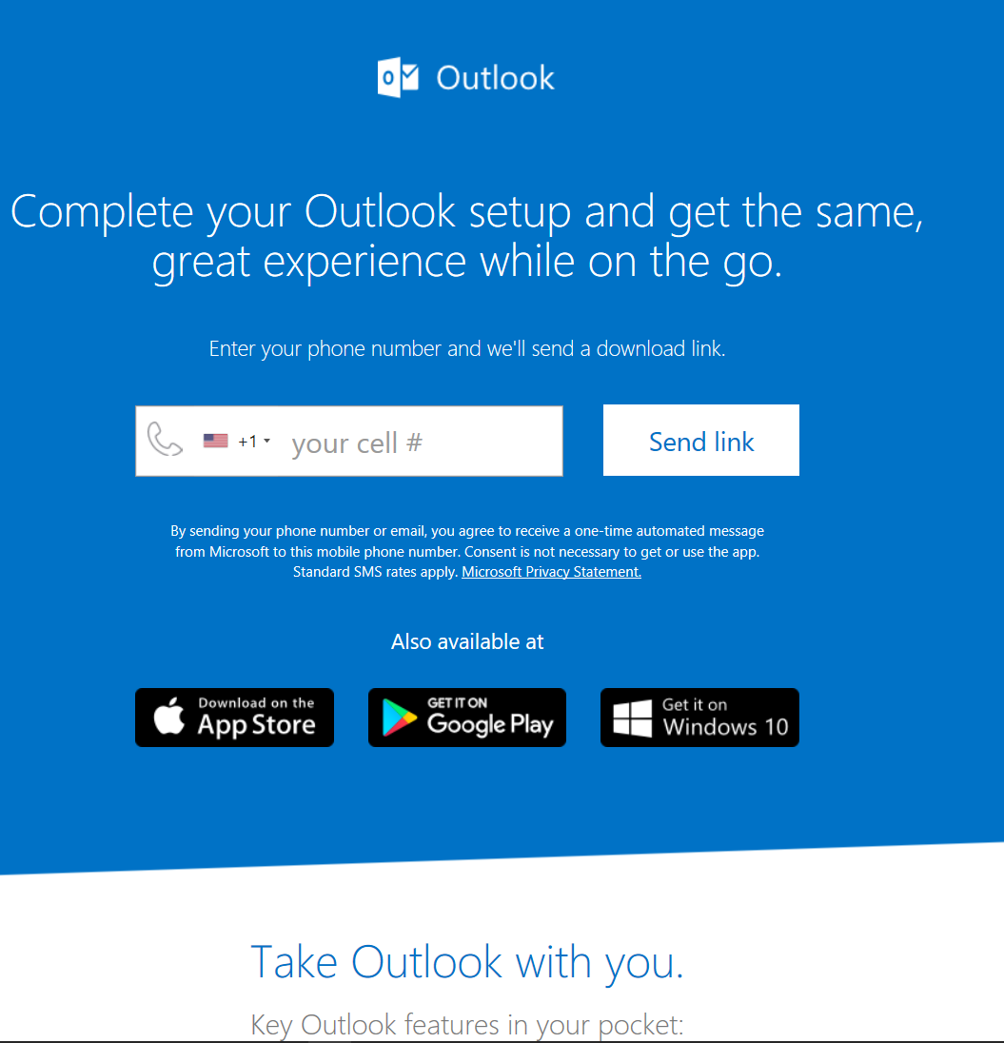
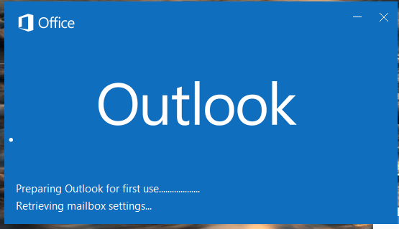
Desktop – Launching Outlook (6 of 7)
You will see the following on your desktop
Outlook will begin to open

Slide 23
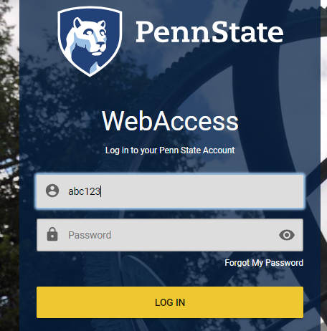
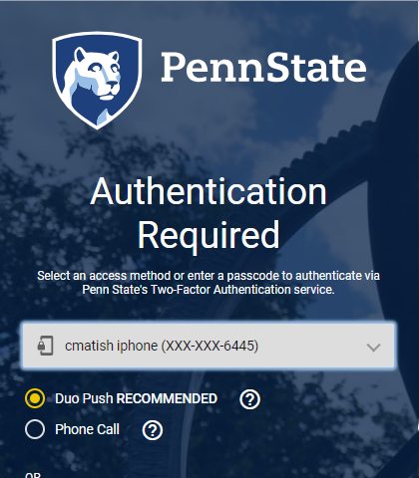
Desktop – Launching Outlook (7 of 7)
Proceed with WebAccess sign in process (one time)
Choose your 2FA preference on “Authentication Required” page
NOTE: You may need to use the “Tab” key to get to the yellow log in button. The scroll option is not always available.

Slide 24
Outlook on the Web
After Migration

Slide 25
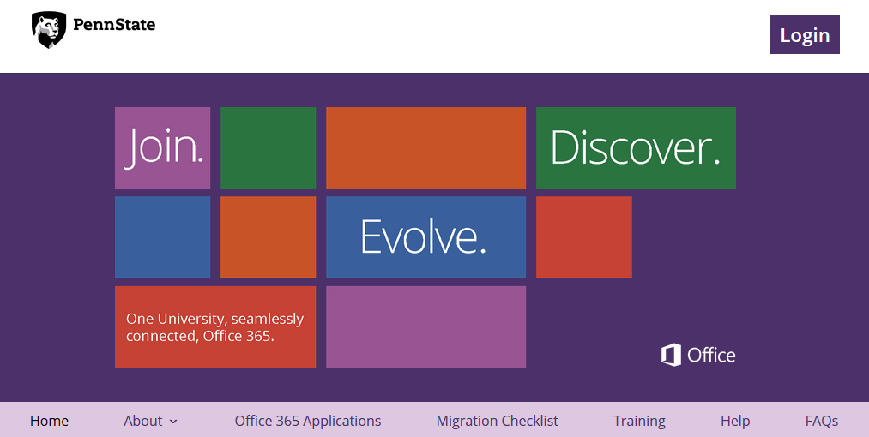
Use Outlook (Web): Login
Go to Penn State Office 365 Portal: Office 365 Portal

Slide 26
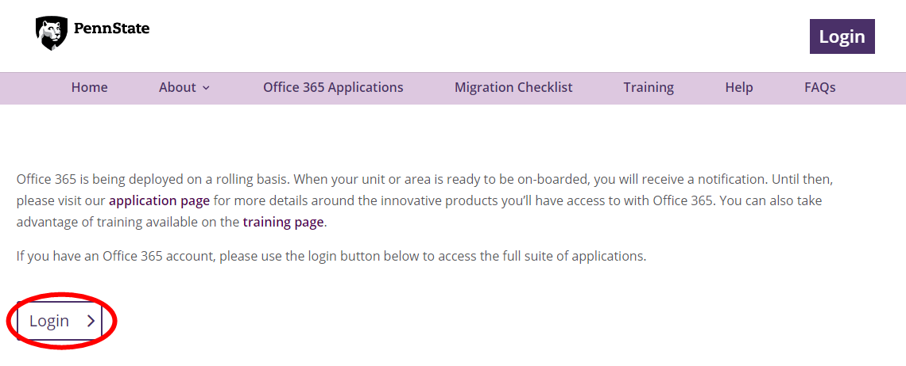
Use Outlook (Web): Login
Login to Office 365

Slide 27
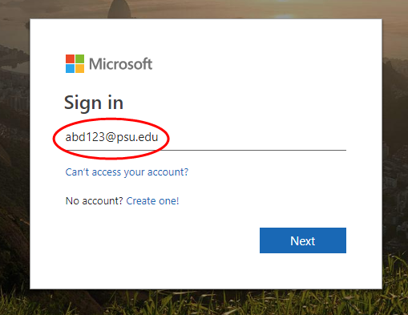
Use Outlook (Web): Login
Login using your Penn State Access ID
Proceed with WebAccess sign in process

Slide 28
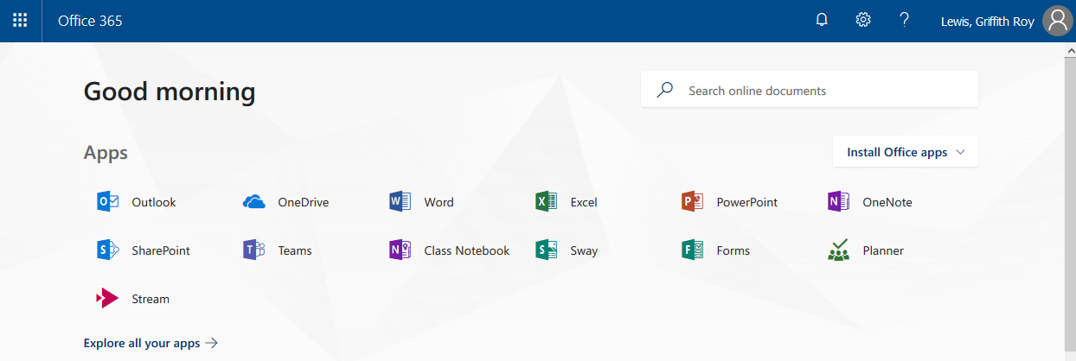
Use Outlook (Web): Select
Select Outlook

Slide 29
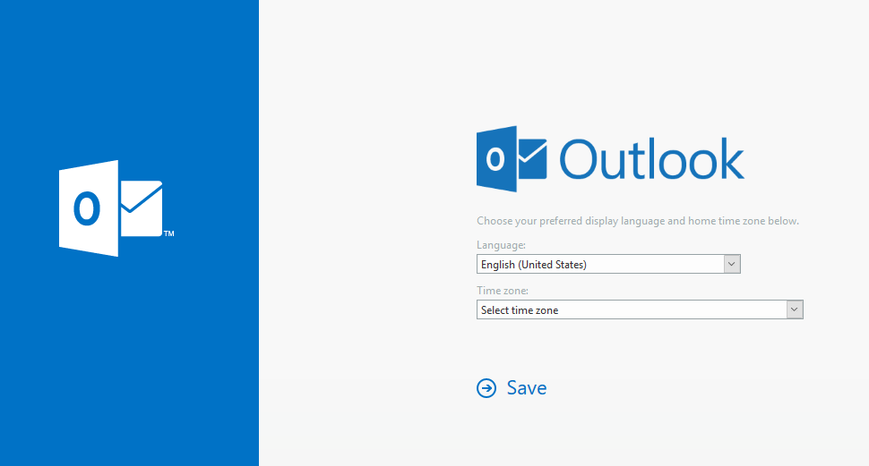
Use Outlook (Web): Configure
Configure (do once)

Slide 30
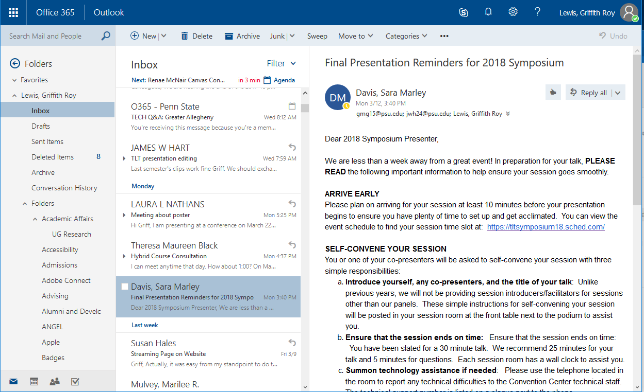
Outlook (Web): Email
Email example

Slide 31
Outlook Calendaring
If you use Calendaring proceed to the following slides
Note: These settings will also reflect in the desktop client

Slide 32
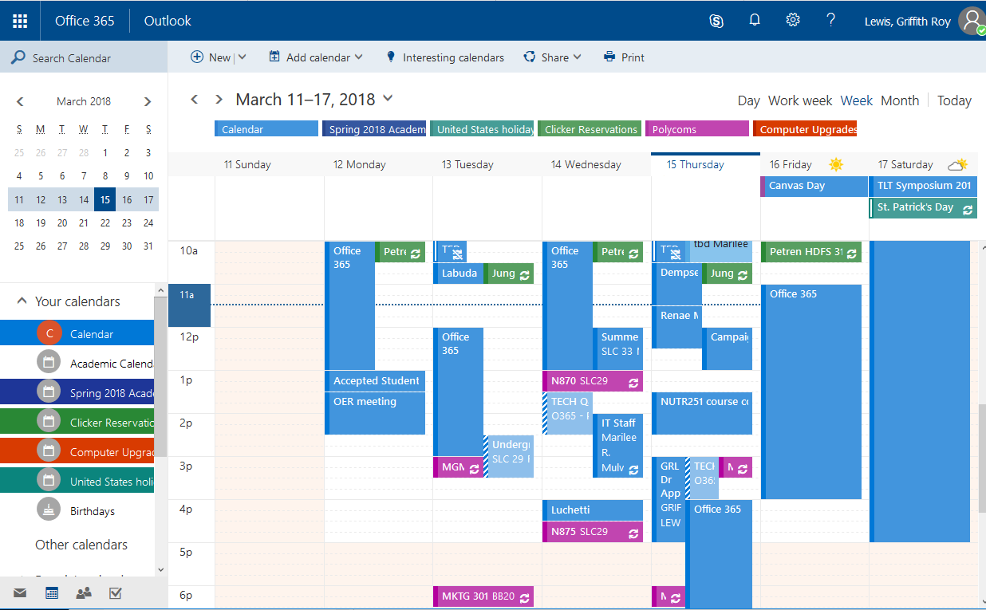
Outlook (Web): Calendar (1 of 3)
Calendar example

Slide 33


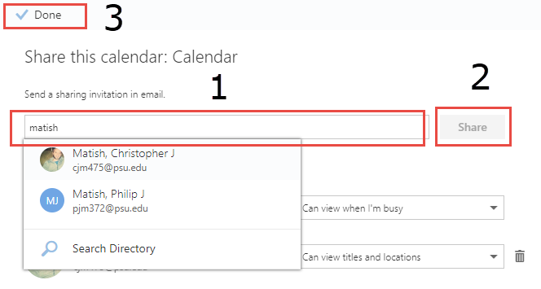
Outlook (Web): Calendar (2 of 3)
Share your calendar
Select Calendar (bottom left)
Select “Share” (top menu)
Search for person to share calendar (1), after selected select “Share”(2), then select “Done”(3)

Slide 34
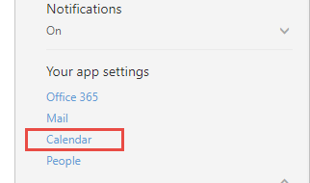
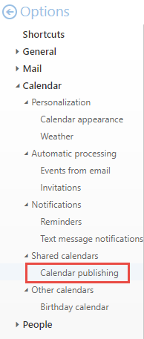
Outlook (Web): Calendar (3 of 3)
Provide a link to your calendar to MyMail (non-migrated) users
Top navigation select “Settings” (gear)
Scroll to bottom select “Calendar”
Left menu select “”Calendar publishing” (under “Shared Calendars”)
Copy this link to place in Email signature

